Slide 1
STUDENT PERFORMANCE ANALYSIS
Hrithika Manayath
Date: 14-10-2024

Slide 2
TABLE OF CONTENT
Introduction
Aim and Objective
Data Description
Data Preprocessing
Exploratory Data Analysis
Machine Learning Algorithm
Data Visualization using Power BI
Conclusion and Future Scope
References

Slide 3
INTRODUCTION
OVERVIEW
In this project, the goal is to analyze key factors that influence student performance using the StudentPerformanceFactors dataset. The dataset includes various attributes such as Hours Studied, Attendance, Sleep Hours, Parental Education Level, and Tutoring Sessions, among others. By exploring these factors, we aim to uncover patterns and insights that can help identify what contributes to high exam scores and overall student success.
BRIEF DESCRIPTION
The analysis will look at how the number of hours studied and sleep habits affect exam scores, and how factors like Peer Influence or Physical Activity might impact academic outcomes. By understanding these relationships, the project could help educators and policymakers make data-driven decisions to improve student performance.

Slide 4
AIM AND OBJECTIVE
AIM
The aim of this project is to analyze the key factors influencing student performance in academic exams.
OBJECTIVE
The objective of this project is to analyze factors affecting student performance, such as sleep hours and parental education levels, and develop a predictive model to forecast exam scores. By exploring the dataset, performing data preprocessing, and conducting analysis, the goal is to provide actionable insights and recommendations to enhance educational outcomes.

Slide 5
DATA DESCRIPTION
Dataset Overview
Source of the Data: The data was sourced from the Student Performance Factors dataset which was taken from Kaggle.
Dataset Size: The dataset consists of 6607 rows and 20 columns.
Data Types: The dataset includes numerical variables such as exam scores, hours studied, and attendance percentages, as well as categorical variables like family income and parental involvement and even Boolean variables like gender , school type.
Target Variable
The primary target variable is Exam Scores, which the dataset aims to predict based on other factors like study habits, parental involvement, and socio-economic indicators.

Slide 6
Key Variables (Columns)
Hours_Studied: Total hours students studied. | Attendance: Student attendance percentage. | Parental_Involvement: Level of parental involvement (categorical). | Access_to_Resources: Availability of educational resources (categorical).
Extracurricular_Activities: Participation in extracurricular activities (categorical). | Sleep_Hours: Average hours of sleep per night. | Previous_Scores: Scores from previous exams. | Motivation_Level: Student motivation level (categorical).
Internet_Access: Access to the internet (categorical). | Tutoring_Sessions: Number of tutoring sessions attended. | Family_Income: Family income level (categorical). | Teacher_Quality: Perceived quality of teachers (categorical).
School_Type: Type of school (categorical). | Peer_Influence: Influence of peers on student performance (categorical). | Physical_Activity: Hours spent on physical activities. | Learning_Disabilities: Presence of learning disabilities (categorical).
Parental_Education_Level: Education level of parents (categorical). | Distance_from_Home: Distance from home to school (categorical). | Gender: Gender of the students (categorical). | Exam_Score: The final score obtained by students.

Slide 7
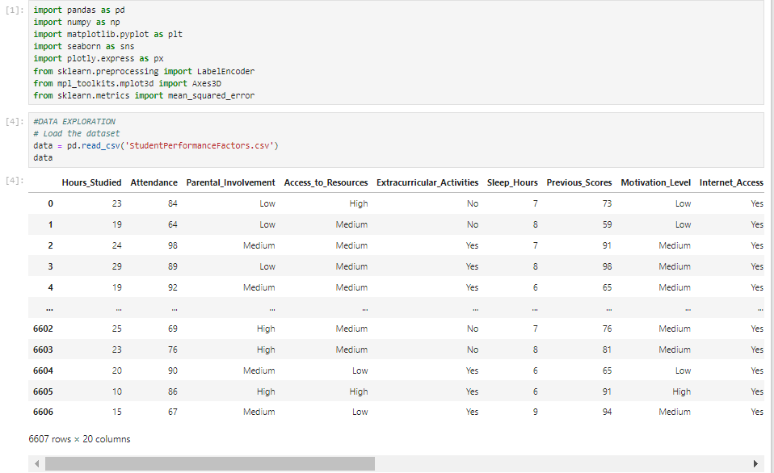
DATA PREPROCESSING
Loading the dataset
The dataset named “StudentPerformanceFactors” contains key variables that affect student performance, setting the stage for comprehensive analysis.
Fig 1: Loaded dataset

Slide 8
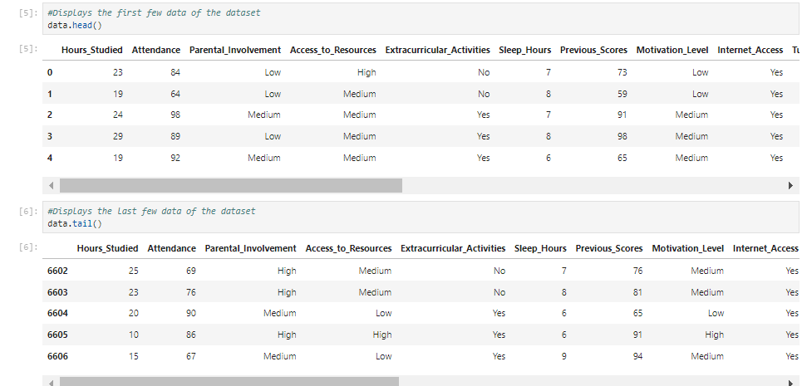
Data Exploration
Fig 2: Figure showing head() and tail() of the dataset

Slide 9
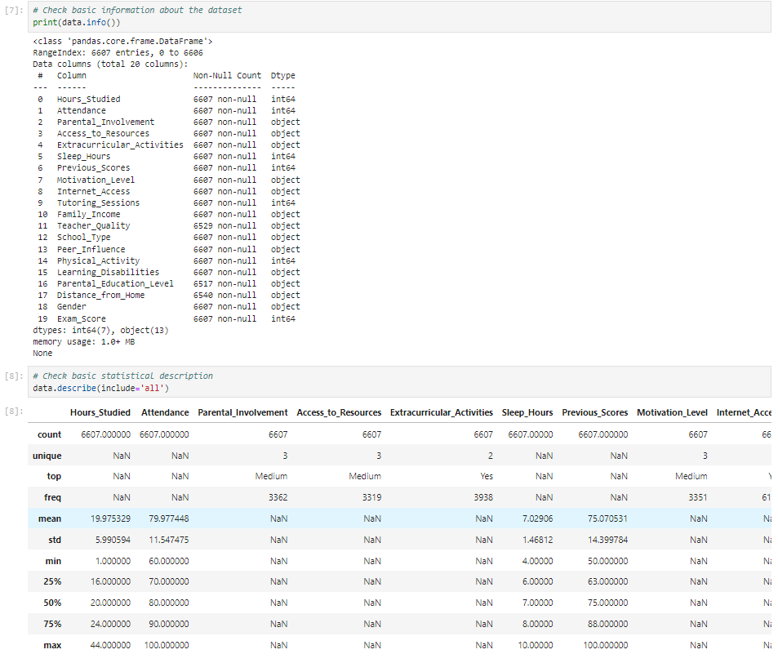
Fig 3:Shows the info() and describe() functions

Slide 10
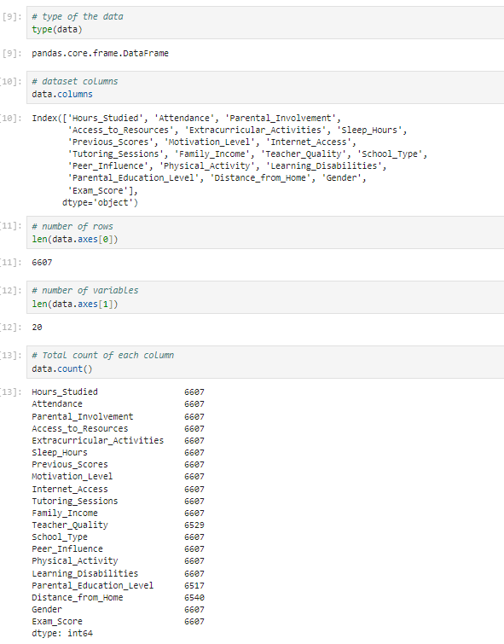
Fig 4: Figure describing other factors

Slide 11
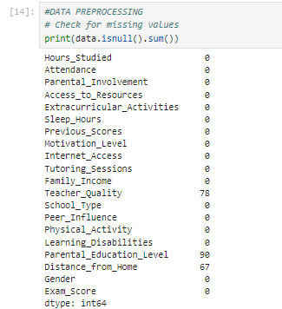
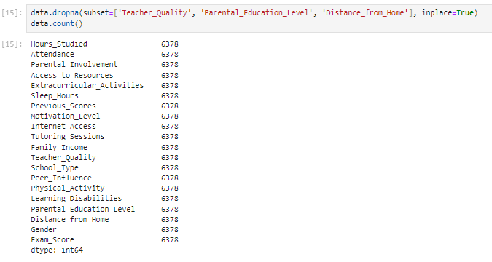
Handling Missing Values
Identified missing values in key columns such as Teacher_Quality, Parental_Education_Level, and Distance_from_Home. Missing values in these columns were handled by removing rows containing missing values:
Fig 5: Figures showing missing values and dropping the rows with missing values

Slide 12
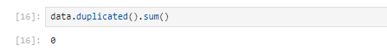
Checking for duplicates Checked for duplicate rows in the dataset using duplicated() function. Duplicate rows was not found in this dataset.
Fig 6: Checking for duplicate values

Slide 13
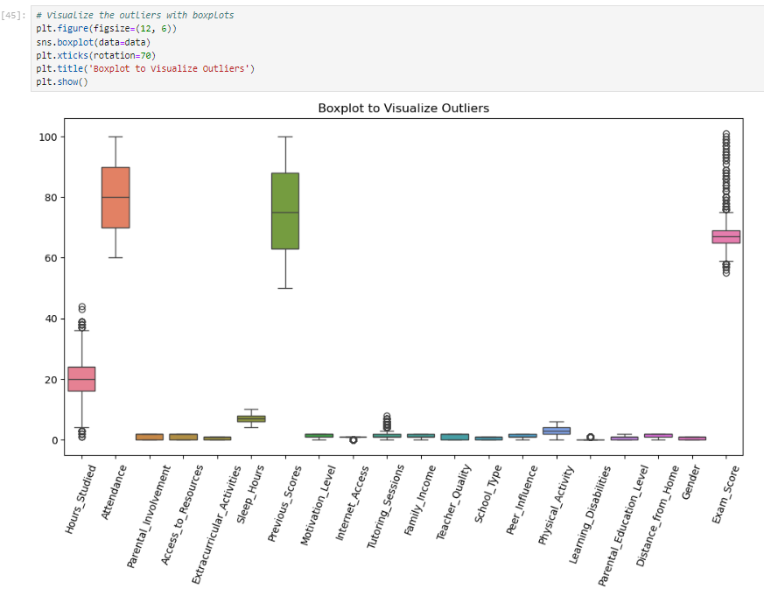
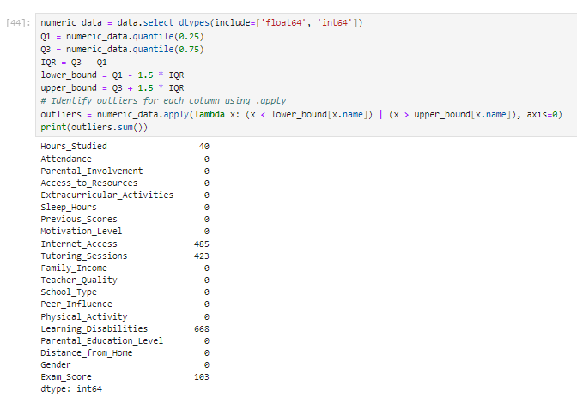
Handling Outliers
Outliers were visualized using a box plot for the entire dataset.
Fig 7: Boxplot visualizing the outliers

Slide 14
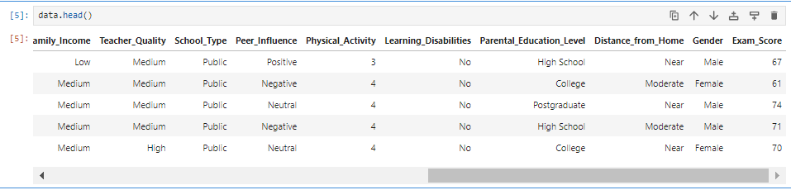
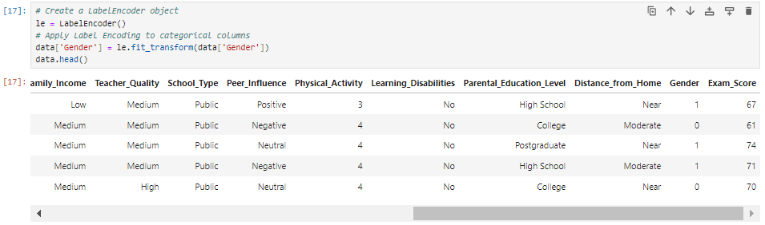
Encoding Categorical Variables
Categorical variables like Gender were transformed into numerical representations using Label Encoding.
Fig 8: Figures showing label encoding

Slide 15
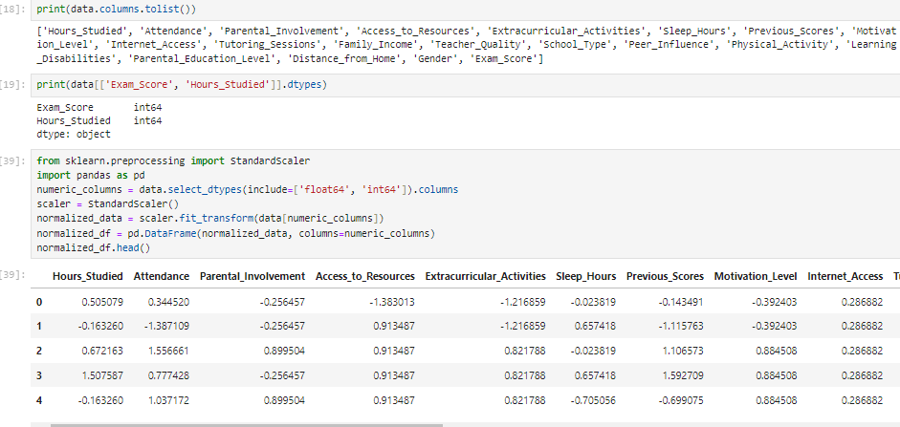
Feature Scaling
While feature scaling hasn't been explicitly applied in the code, it is typically handled using methods such as StandardScaler or MinMaxScaler to normalize the data (especially for algorithms sensitive to feature magnitude).Example for potential scaling of numerical variables (e.g., Exam_Score, Hours_Studied, etc.)
Fig 9: Shows standardization

Slide 16
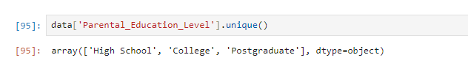
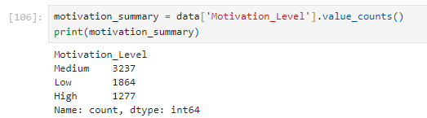
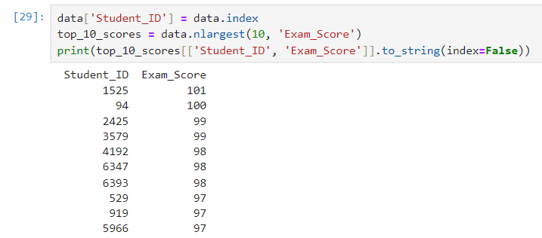
Dataset Analysis
Fig 10: Shows the unique educational levels of parents
Fig 11: Figure tells the total count of each motivational level
Fig 12: Snip shows the highest 10 exam scores

Slide 17
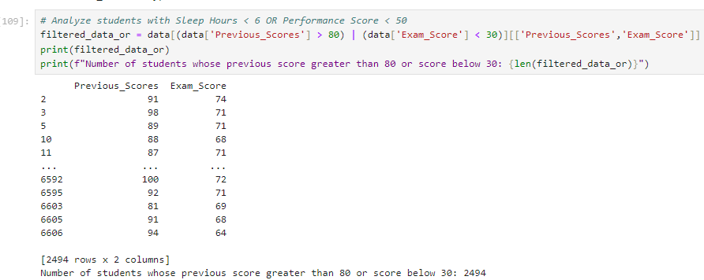
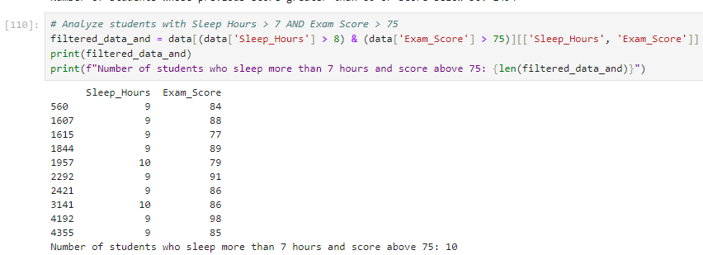
Fig 13: Analyzes the previous scores and current score
Fig 14: Analyzes the sleep hours and exam scores

Slide 18
EXPLORATORY DATA ANALYSIS
UNIVARIATE ANALYSIS
Univariate analysis is the simplest form of data analysis, focusing on examining and describing a single variable at a time.
It involves analyzing the distribution, central tendency (mean, median, mode), dispersion (range, variance, standard deviation), and shape (skewness, kurtosis) of the variable through visualizations like histograms, bar charts, and box plots.
This type of analysis is foundational in statistics and data science, as it allows for understanding the distribution, central tendency, and spread of data before diving into more complex multivariate analyses.
Companies use univariate analysis to analyze consumer preferences for individual product attributes, helping to inform marketing strategies.
Educators can use univariate analysis to evaluate student performance metrics (like exam scores) based on individual factors such as study hours or parental involvement. It helps identify areas for improvement in teaching methods or curriculum design.

Slide 19
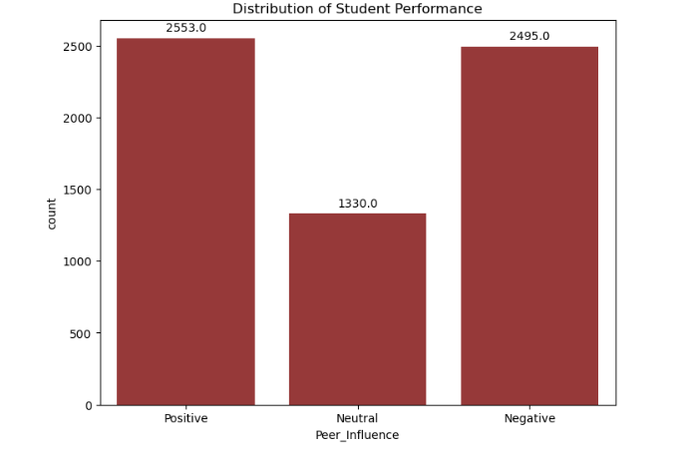
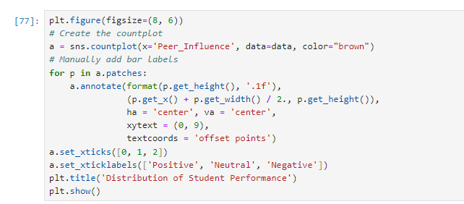
Data Visualization
The count plot displays the distribution of Peer Influence levels among students, categorized as Positive, Neutral, and Negative. It shows that most students experience Positive peer influence, with fewer reporting Neutral or Negative influences.
Fig 15: Univariate analysis of Peer Influence

Slide 20
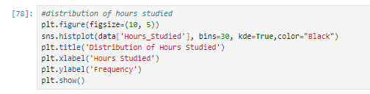
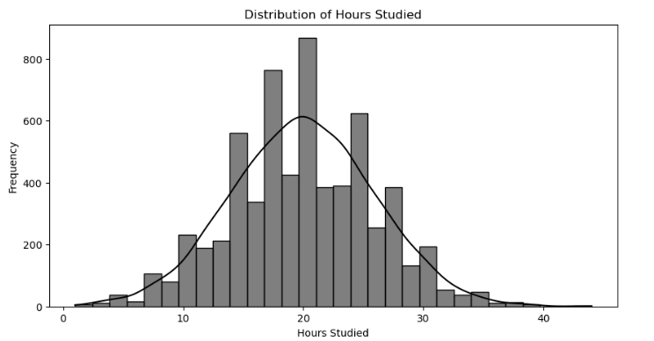
The histogram shows the distribution of Hours Studied among students, with most studying between 10 to 30 hours. The KDE overlay highlights the concentration of study time in this range.
Fig 16: Univariate analysis of Hours Studied

Slide 21
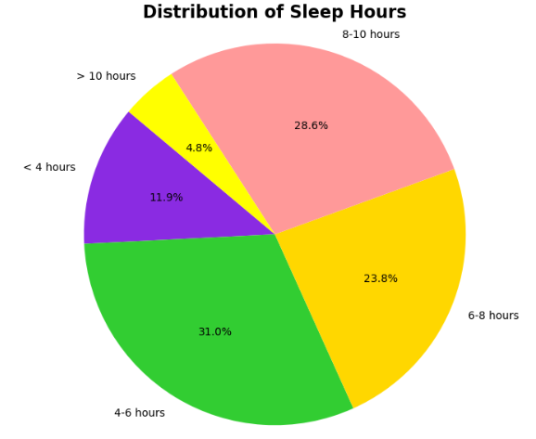
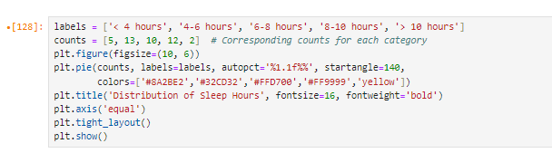
The pie chart illustrates the distribution of Sleep Hours among students, highlighting the proportion of various sleep duration categories. The majority of students fall within the 4-6 hours and 8-10 hours categories, indicating prevalent sleep patterns among the population.
Fig 17: Univariate analysis of Distribution
of sleep hours

Slide 22
BIVARIATE ANALYSIS
Bivariate analysis is a statistical technique that involves the examination of the relationship between two variables.
It helps in understanding how one variable affects or correlates with another.
In the context of educational data, it can help identify patterns, correlations, and dependencies between different factors that might influence student performance.
It is a powerful tool in educational research, enabling deeper insights into how different factors interact and influence student outcomes.
By identifying relationships, educators can tailor their approaches to improve student performance and overall learning experiences.

Slide 23
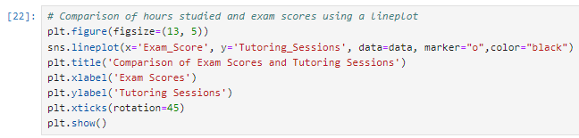
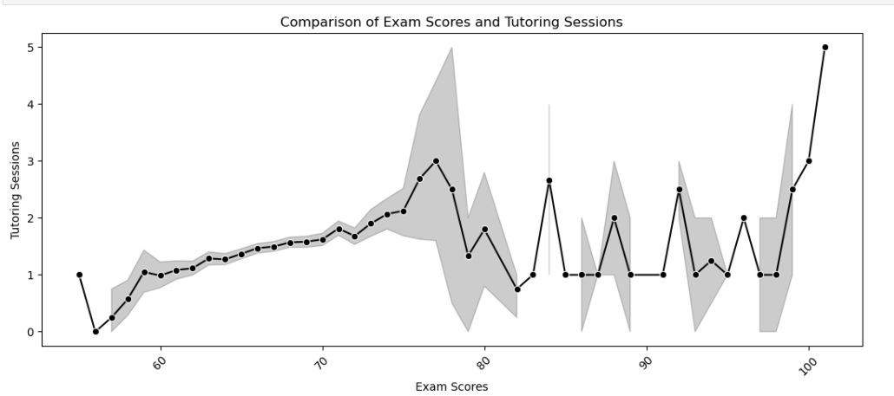
Data Visualization
Line plots displayed the relationship between Tutoring Sessions and Exam Scores, showing how tutoring impacts student performance across different score ranges.
Fig 18: Bivariate analysis between Exam Scores and Tutoring Sessions

Slide 24
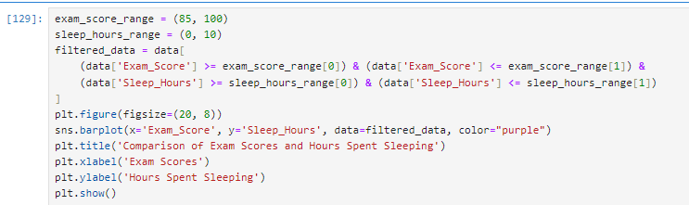
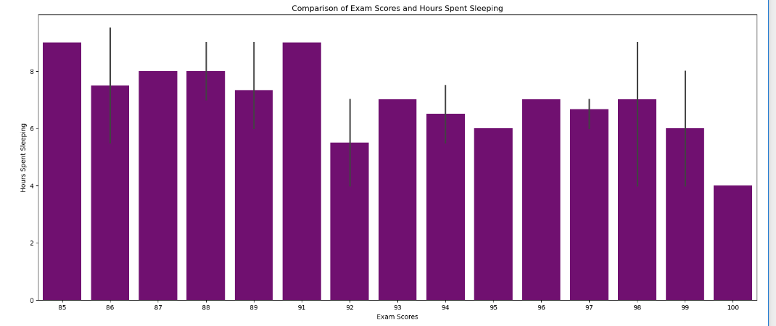
Bar plots highlighted the correlation between Exam Scores and Hours Spent Sleeping within the specified range, indicating how varying sleep durations affect performance in higher score ranges.
Fig 19: Bivariate analysis of Exam Scores and Hours Spent Sleeping

Slide 25
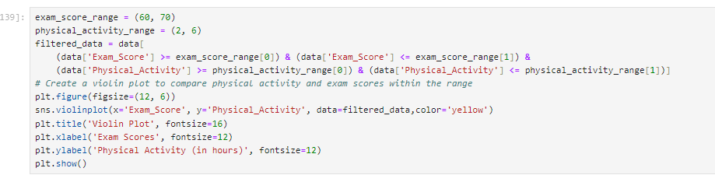
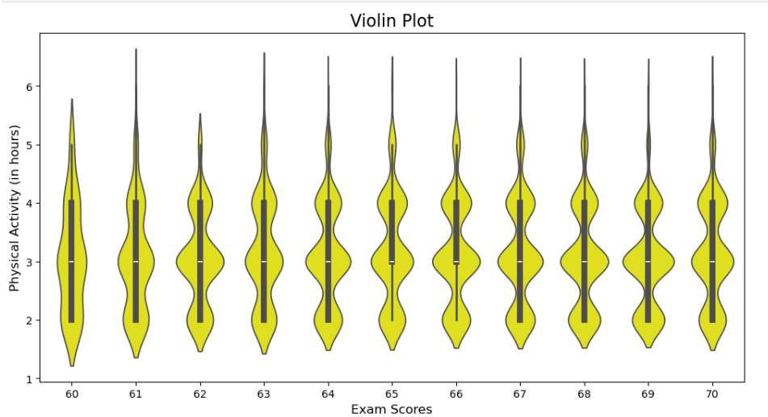
Violin plots shows the distribution of Physical Activity and Exam Scores, revealing the variation in activity levels for students with exam scores between 60 and 70.
Fig 20: Bivariate analysis of Exam Scores and Physical Activity using Violin Plot

Slide 26
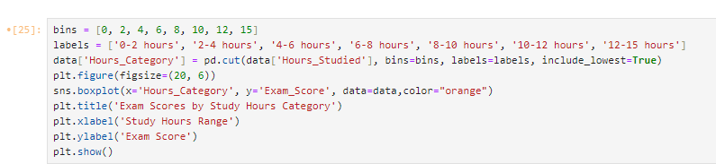
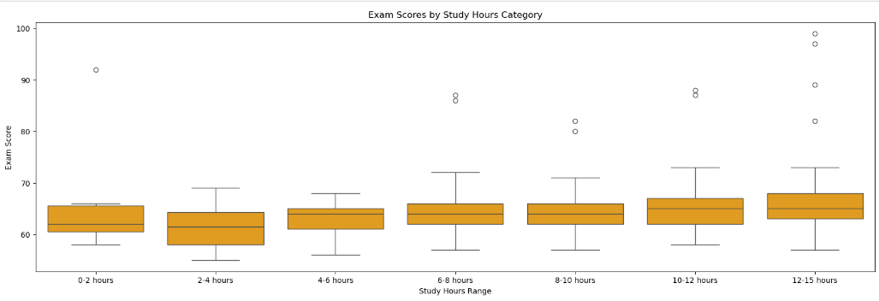
Box plots demonstrated the distribution of Exam Scores across different Study Hours Categories, showing how more hours studied generally led to higher performance, with specific ranges highlighting variability in scores.
Fig 20: Bivariate analysis of Exam Scores and Study Hours using Box Plot

Slide 27
MULTIVARIATE ANALYSIS
Multivariate analysis is a statistical technique used to examine the relationships among three or more variables simultaneously.
This analysis helps in understanding how different variables interact with each other and influence a particular outcome or dependent variable.
One of the primary objectives of multivariate analysis is to uncover patterns and trends in data that can inform educational practices and policies.
For instance, multiple regression analysis can be employed to predict student exam scores based on several independent variables, such as hours studied, attendance rates, sleep hours, and participation in tutoring sessions.
It is particularly useful in educational research, allowing researchers to understand complex relationships and interactions between several factors that influence outcomes like student performance.
By examining how various factors influence each other and their collective impact on a dependent variable, multivariate analysis aids in creating a more comprehensive understanding of student performance.
By leveraging these techniques, educators and researchers can gain deeper insights into student performance and identify effective strategies to enhance learning outcomes.

Slide 28
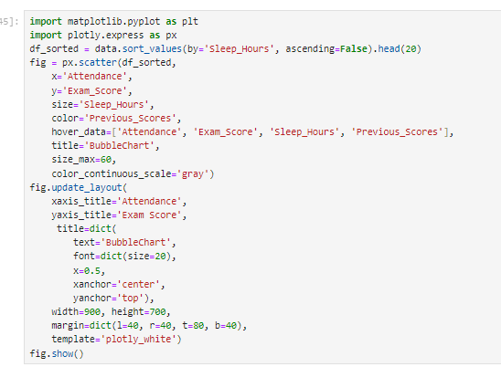
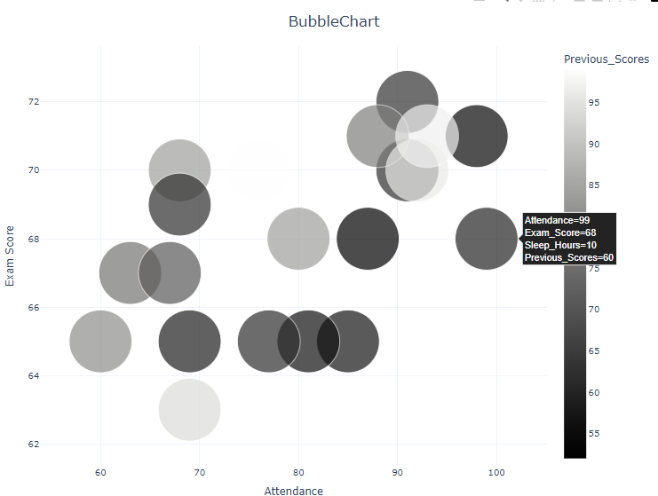
Data Visualization
The bubble chart visualizes the relationship between Attendance and Exam Score, with bubble sizes representing Sleep Hours and colors indicating Previous Scores. It highlights the top 15 data points, providing insights through customized labels and an interactive layout.
Fig 21: Multivariate analysis among Exam Scores, Attendance, Sleep Hours and Previous Scores using Bubble Chart

Slide 29
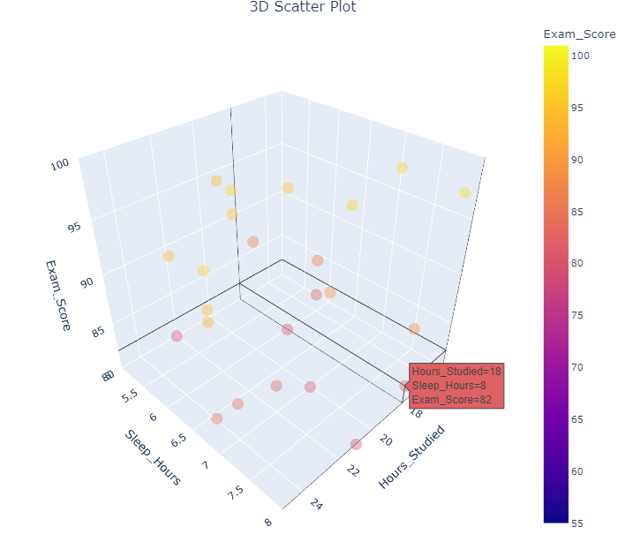
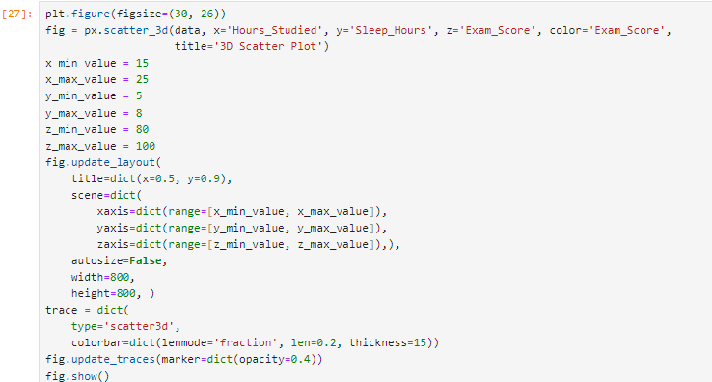
A 3D scatter plot was generated to visualize the relationship between Hours Studied, Sleep Hours, and Exam Scores, allowing for an interactive exploration of how these variables correlate, with the axes customized to focus on specific ranges for clearer insights into student performance.
Fig 22: Multivariate analysis of Exam Scores, Study Hours and
Sleep Hours using 3D Scatter Plot

Slide 30
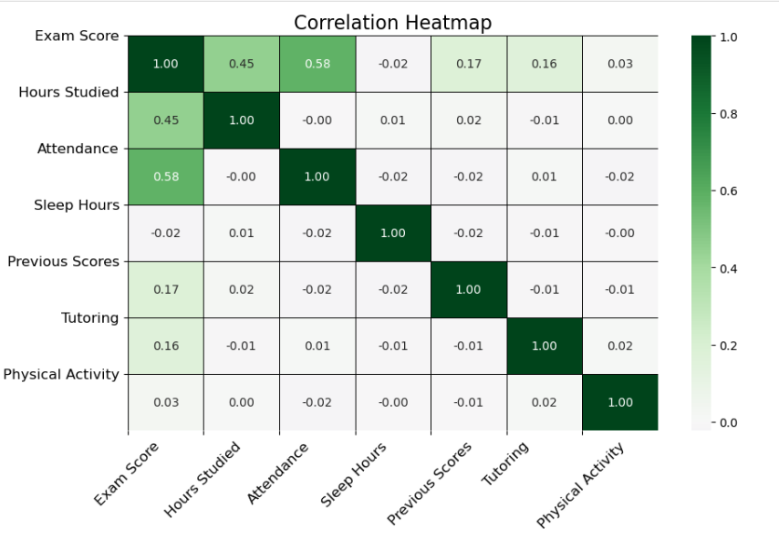
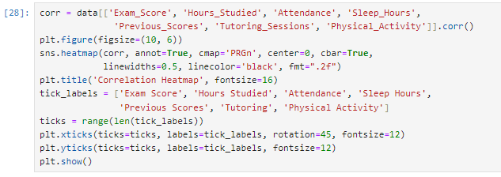
The correlation heatmap illustrates the strength and direction of relationships among critical factors influencing student performance, including Exam Score, Hours Studied, Attendance, Sleep Hours, Previous Scores, Tutoring Sessions, and Physical Activity.
Fig 23: Correlation Heatmap visualizing multivariate analysis

Slide 31
MACHINE LEARNING ALGORITHM
Machine learning algorithms are computational methods that enable systems to learn from data, identify patterns, and make decisions or predictions without being explicitly programmed, allowing for automation and enhanced insights across various domains such as finance, healthcare, and education.
In this analysis, categorical variables are converted into numerical formats using LabelEncoder to facilitate their inclusion in a linear regression model.
A feature matrix, X, is constructed from relevant variables influencing student performance, specifically Exam_Score.
The dataset is split into training and testing sets, with a linear regression model trained on the training data.
The model's performance is evaluated using the R² score and Mean Squared Error (MSE), providing insights into its predictive accuracy.
This structured approach ensures that the model is effectively trained and assessed, laying the groundwork for further educational data analysis.

Slide 32
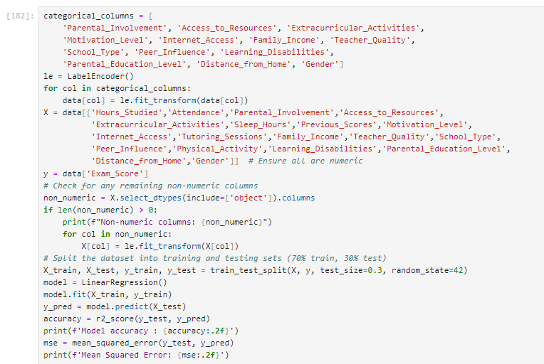
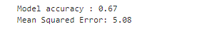
Code:
Output:

Slide 33
DATA VISUALIZATION USING POWER BI
Power BI is a dynamic tool for transforming raw data into visually interactive reports and dashboards. It offers a wide range of visualizations such as bar charts, line graphs, heatmaps, and more, enabling us to analyze data effectively.
With seamless connectivity to multiple data sources, real-time updates, and drill-down features, Power BI allows us to explore insights, identify trends, and make informed decisions with ease.
Its interactive nature makes data exploration intuitive and enhances the ability to communicate complex data stories clearly.
For my analysis, I utilized Power BI to create dynamic and interactive visualizations.
Power BI allowed me to explore various trends and relationships within the dataset, offering insights through detailed dashboards.
The Power BI report titled "BI Analysis" provides valuable insights into my data analytics findings. This report visualizes key metrics and trends, facilitating informed decision-making. Link to Report: "C:\Users\ASUS\Data analytics\BI Analysis.pbix"

Slide 34
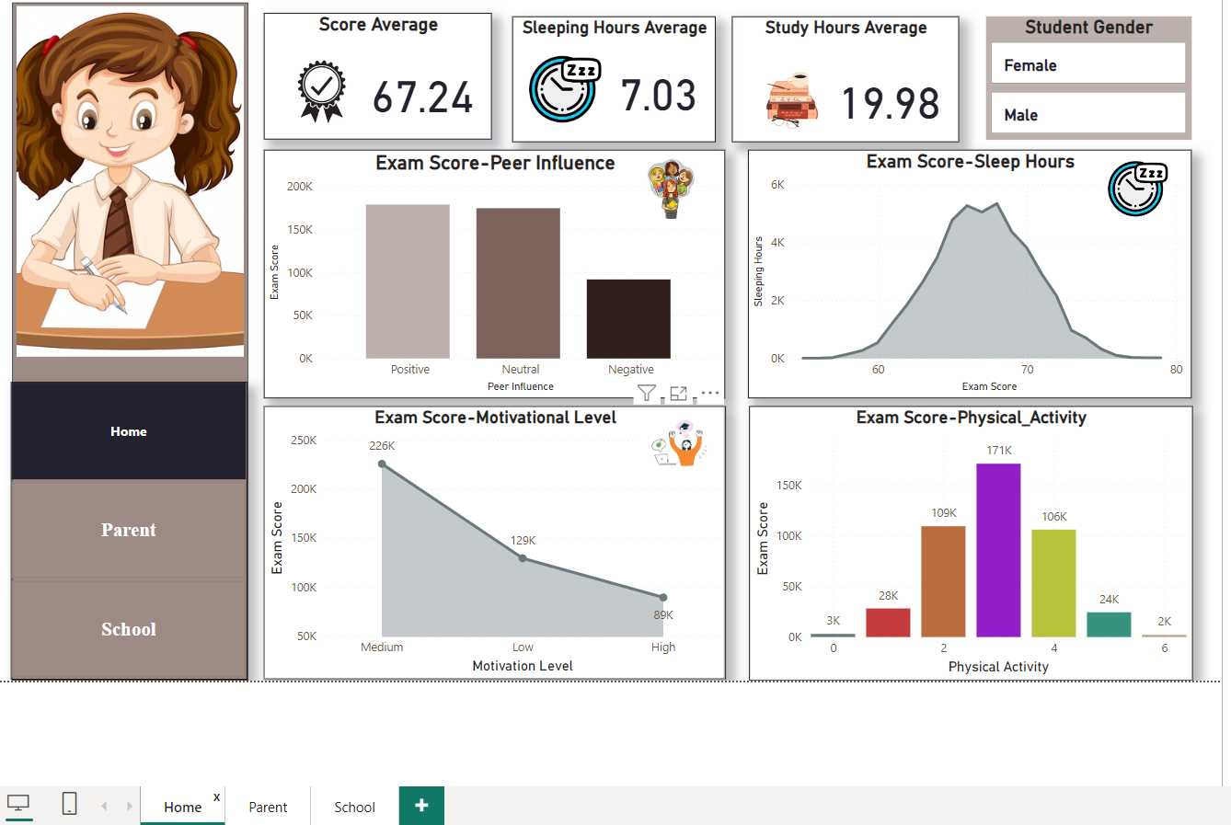
This Power BI dashboard provides a comprehensive overview of various factors influencing student performance. The top section displays key metrics such as the average score (67.24), sleeping hours (7.03), and study hours (19.98), along with student gender distribution. Visuals include bar charts representing peer influence on exam scores, with positive, neutral, and negative categories, as well as a line chart showing the correlation between motivational levels and exam scores. Additionally, the dashboard features a density plot linking exam scores with sleep hours and a bar chart indicating the relationship between physical activity and academic performance. Each of these elements helps in understanding how different factors contribute to overall student outcomes.
Fig 24: Dashboard focusing on Home factor

Slide 35
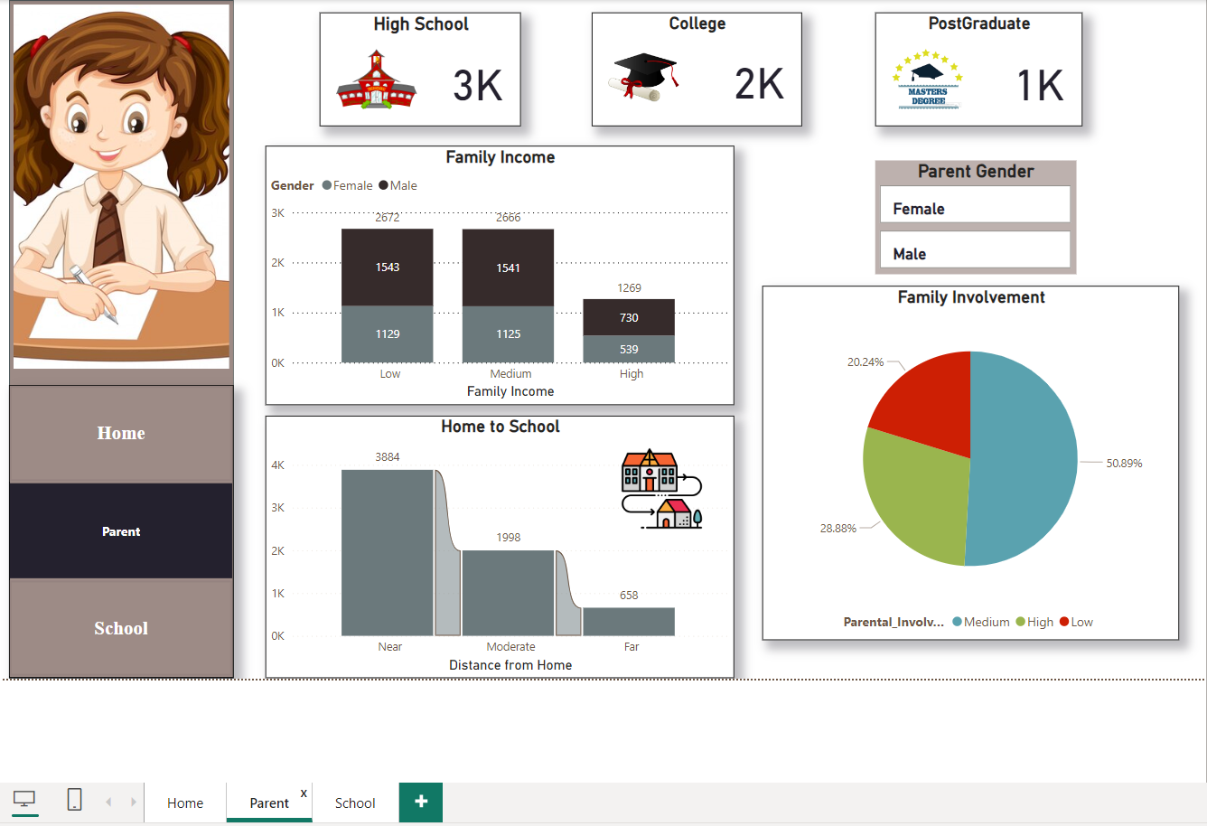
The dashboard presents educational data, showing student numbers at different education levels (high school, college, and postgraduate), family income distribution by gender, and the distance from home to school. It also highlights parental involvement levels and includes a filter to view data based on parent gender. The visualizations offer insights into student demographics, family background, and parent participation.
Fig 25: Dashboard focusing on Parent factor

Slide 36
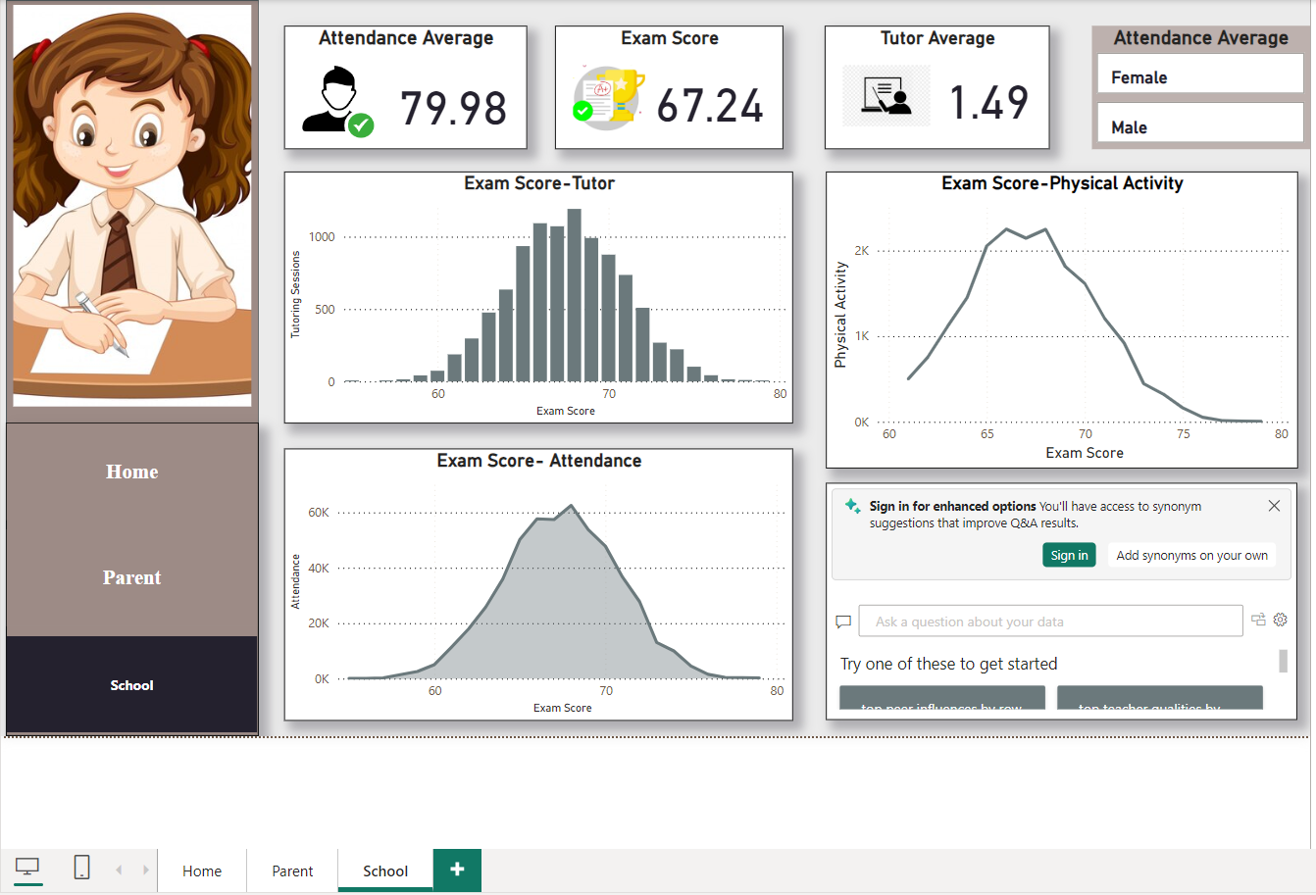
This dashboard highlights student performance, showing an average attendance of 79.98 and exam score of 67.24. It displays correlations between exam scores and factors like tutoring, attendance, and physical activity. The charts suggest that higher exam scores are associated with more tutoring sessions, better attendance, and moderate physical activity. A filter allows analysis by gender.
Fig 26: Dashboard focusing on School factor

Slide 37
CONCLUSION AND FUTURE SCOPE
Conclusion
The analysis revealed strong correlations between academic performance, study habits, attendance, and sleep patterns, emphasizing that students who dedicate more time to studying and maintain good attendance tend to achieve higher exam scores. Additionally, regular physical activity positively influences academic outcomes. Gender differences in study habits also suggest the need for tailored educational strategies. These findings underscore the importance of holistic approaches in education, focusing on both academic and well-being factors to enhance student performance.
Future Scope
The future scope from this analysis can pave the way for improving student learning experiences by focusing on key factors such as study habits, sleep patterns, and attendance. Future research could explore how personalized teaching methods can better meet the needs of individual students, considering differences like gender. Additionally, incorporating technology that adapts to each student's learning style could enhance educational effectiveness. Long-term studies may help us understand the lasting impact of these factors on academic performance. Ultimately, applying these insights in real classrooms can guide teachers in developing better strategies to support students and foster their success.

Slide 38
Real-World Applications
The insights gained from this study can be applied in various areas. For educators, understanding the relationship between study habits and exam scores can help tailor teaching strategies to improve student outcomes. Schools might implement programs promoting better sleep and attendance, leading to overall better academic performance. Additionally, educational policymakers can use this information to design interventions that support students' learning needs. Finally, parents can also benefit from these findings by fostering positive study habits and ensuring their children have adequate rest, ultimately enhancing their academic success.

Slide 39
REFERENCES
Dataset: Kaggle. (2022, January 15). Student Performance Factors Dataset. https://www.kaggle.com/datasets/studentperformance
Data Preprocessing Techniques. (n.d.): Guidelines and methodologies for handling missing values, outliers, and categorical variables in datasets. Retrieved from https://towardsdatascience.com/data-preprocessing-techniques-in-machine-learning-with-python-9f3c42e45231
Machine Learning Algorithms. (n.d.). Overview of algorithms used for predictive modeling in education, focusing on their applications to improve student outcomes. Retrieved from https://www.geeksforgeeks.org/machine-learning-algorithms/
Statistical Software Documentation. (n.d.). User manuals and online resources for tools like Python, Pandas, and Seaborn, essential for data analysis and visualization. Retrieved from https://www.youtube.com/watch?v=vmEHCJofslg (Corey Schafer's Python Pandas Tutorial).

Slide 40
Exploratory Data Analysis Techniques. (n.d.). Techniques utilized for analyzing data distributions and relationships among variables, including univariate, bivariate, and multivariate analysis. Retrieved from https://www.kaggle.com/code/imoore/intro-to-exploratory-data-analysis-eda-in-python
Power BI Tutorial: Analyze Student Performance Dataset. (n.d.). This tutorial explores how to visualize and analyze student performance data using Power BI, providing insights into various performance metrics. Retrieved from https://youtu.be/0BKlUySopU4?si=-HVXeUa28p7-nhOA

Slide 41


